Slide 1
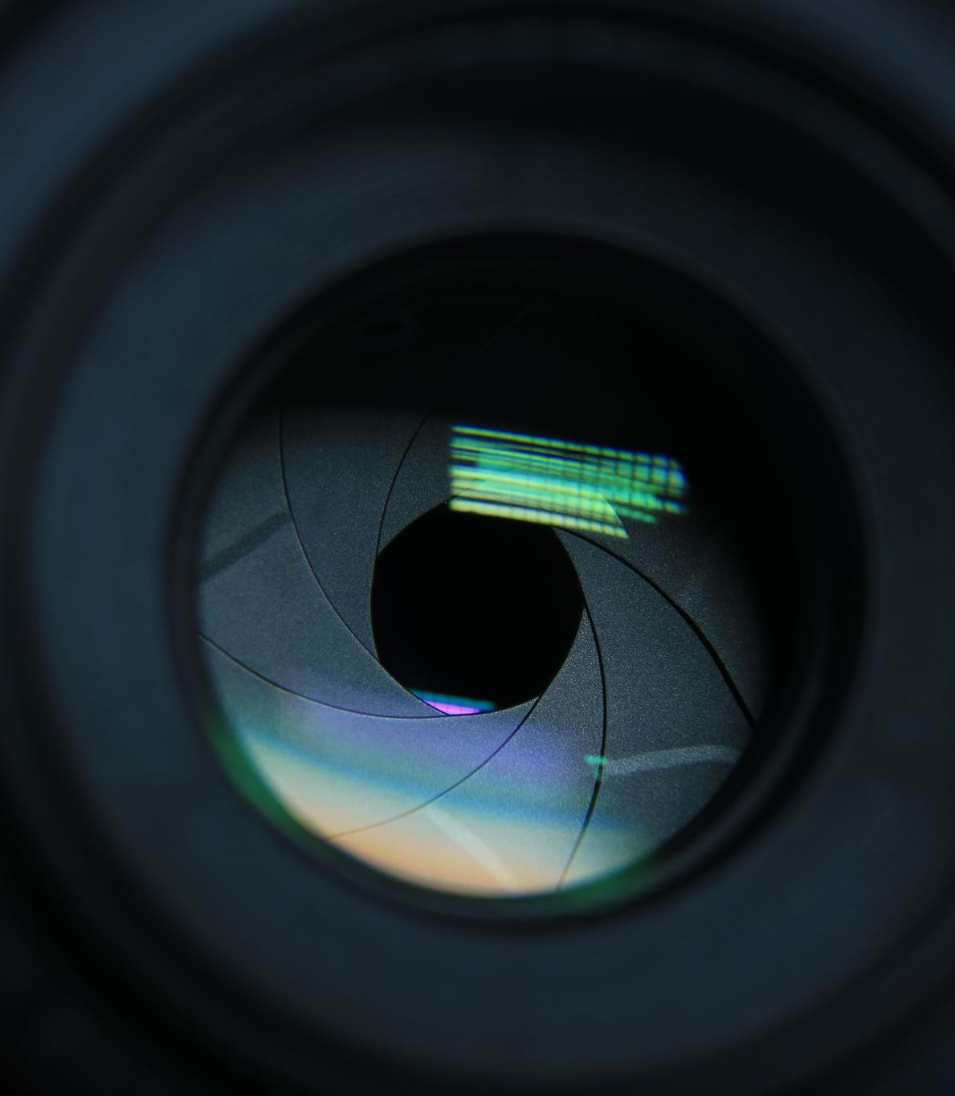
PRNU Device Recognition
Identifying the Origin of Images through PRNU

Slide 2
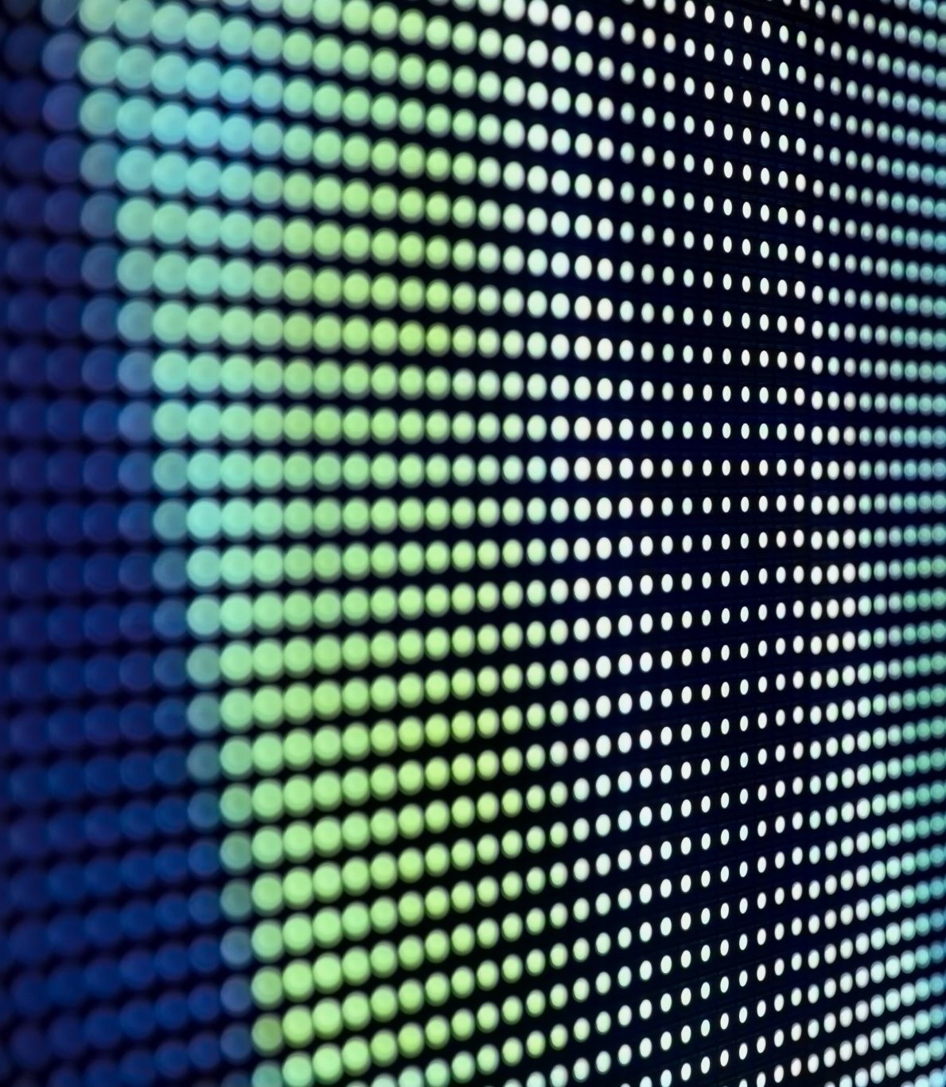
What is PRNU ?
Photo Response Non-Uniformity (PRNU) is a distinctive noise pattern intrinsic to imaging sensors in digital cameras.
This issue arises from slight variations in pixel sensitivity across the sensor array.
Manufacturing imperfections lead to unique patterns of noise in sensors.

Slide 3
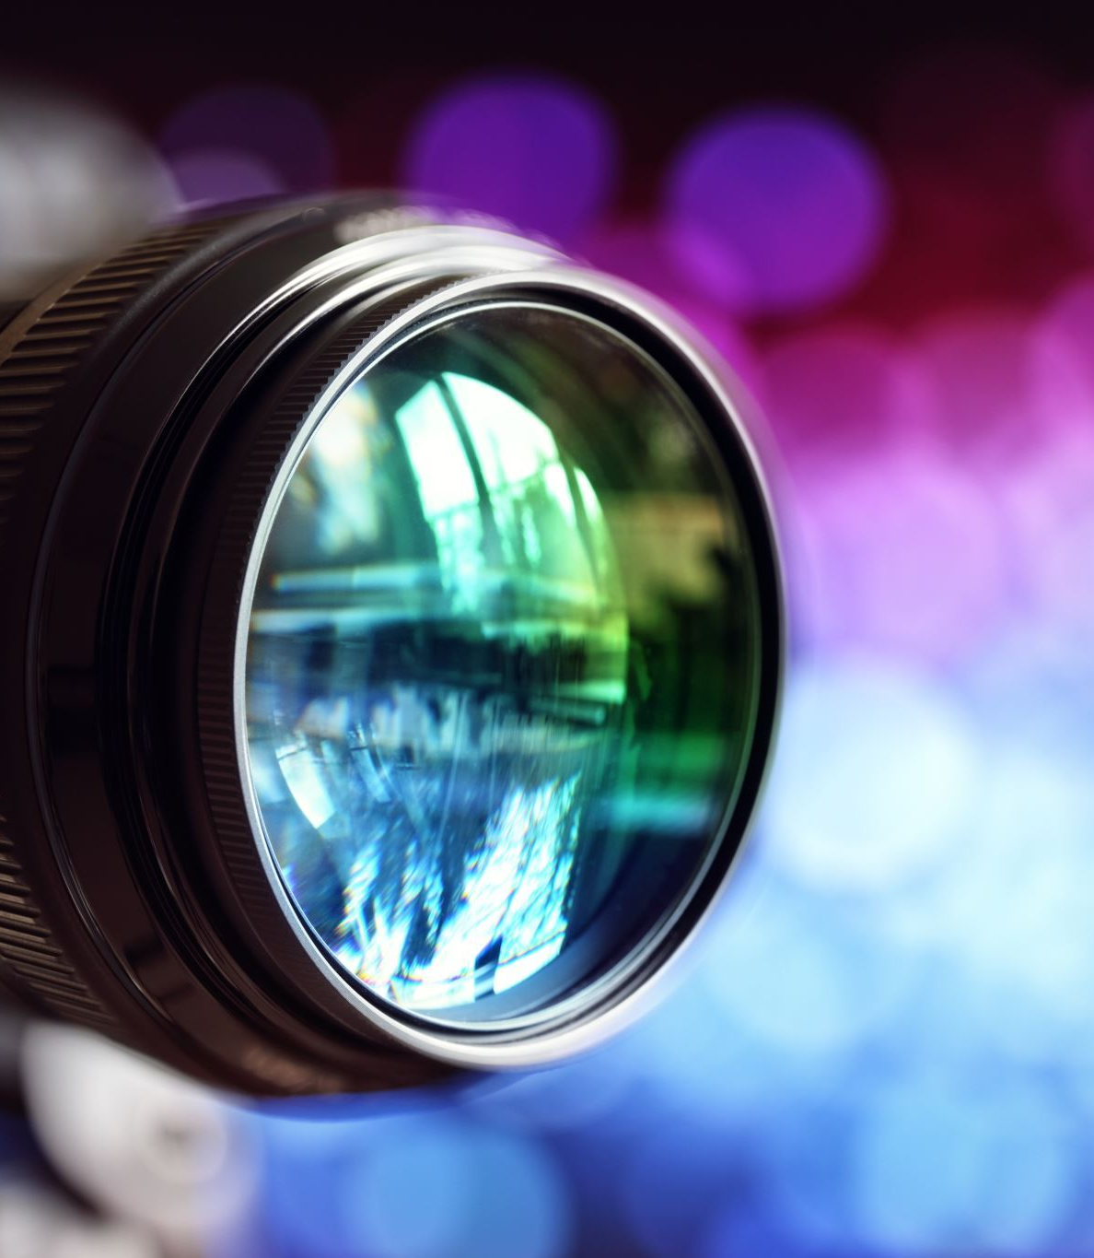
Detailed Explanation
1. Characteristics: PRNU is a "fingerprint" for a camera sensor, stable over time and across different conditions, making it reliable for sensor identification.
2. Detection: PRNU is detected by denoising the image (e.g., with Gaussian filtering) and analyzing the residual noise pattern.
3. Application: In digital forensics, PRNU links images to specific cameras. By comparing PRNU patterns, the camera that captured the image can be identified.
4. Importance: PRNU is crucial for detecting image forgeries, authenticating image sources, and investigating digital crimes.

Slide 4

My project
Objective: Develop a system to identify the origin of photos by analyzing the Photo Response Non-Uniformity (PRNU) pattern.
Specific Goal: Accurately determine which of the five different devices captured a given image by comparing its PRNU pattern to known patterns from each device and calculate its accuracy.

Slide 5
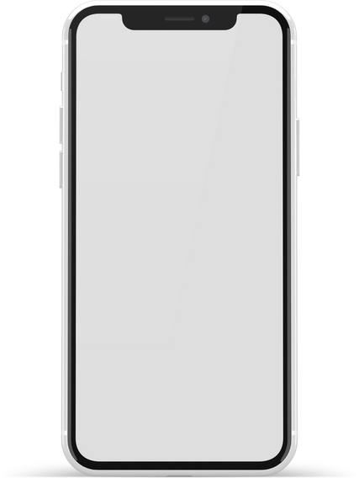




SCHEMA

Slide 6

METODOLOGY
1. Data Preparation
Dataset: Downloaded a dataset containing images from five different devices.
Organization: Organized images into folders corresponding to each device.
2. Image Preprocessing
Conversion to Grayscale: Converted images to grayscale to simplify PRNU extraction.
Histogram Equalization: Applied histogram equalization for normalization.
Resizing: Resized images to a uniform size (700x1080 pixels)
3. PRNU Extraction
Denoising: Used Gaussian filtering to remove scene content from images.
Noise Residual Calculation: Subtracted the denoised image from the original image to obtain the noise residual.
Normalization: Normalized the noise residual to highlight the PRNU pattern.

Slide 7

METODOLOGY
4. PRNU Averaging
PRNU Calculation: Calculated the average PRNU pattern for each device using multiple images.
5. Classification
PRNU Comparison: Extracted PRNU from test images and compared it with the average PRNU patterns of the known devices.
Similarity Measurement: Used Euclidean distance to measure the similarity between the PRNU patterns.
Device Identification: Classified the test image to the device with the closest PRNU pattern.
6. Accuracy Calculation
Testing: Used a set of labeled test images to evaluate the accuracy of the classification system.
Metrics: Calculated the accuracy by comparing predicted labels with true labels.

Slide 8


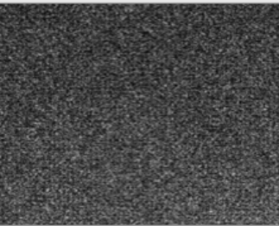

SCHEMA
Noise Extraction
Prnu estimate
residual noise extraction
YES
Correlation
NO

Slide 9

DATASET
The dataset used for this project was the Vision dataset, specifically images from five different devices. This dataset was provided by Lesc DINFO UNIFI. Special thanks to the provider for making this dataset available.
The 5 devices are:
Samsung_GalaxyS3Mini
Apple_iPhone4s
Huawei_P9
LG_D290
Apple_iPhone5c

Slide 10
THE END
Bertolami Carmelo
Digital forensics course 2023/2024

